Slide 1
Library
A Videogame rental company
Presented by: Kristoffer James Bomediano
Notes:
Illustration: Freepik

Slide 2
Gaming in the Philippines
Growth of the Indusrty
The Gaming industry has grown significantly in our country in the recent years.
43 million active Filipino players.
With an increase of 12.9% yearly since the year 2017
Major Companies
The gaming industry in the Philippines has attracted the attention of major gaming companies. One example is Ubisoft which is located in Santa Rosa, Laguna.
Source: https://m2comms.com/2023/02/17/gaming-in-the-philippines

Slide 3


Welcome
to
The Company Logo
The concept « Library » was chosen because of the similarity of this company to an actual library, wherein a real library you typically borrow books, while in Library you borrow games.
The three stacked items on the left are the cases of games represents our three main target gaming platforms such as the Nintendo Switch, Playstation, and the Xbox
The line below the company name represents a shelf where we usuallly put our games.
The Brand

Slide 4






Growing Market
Less Playing Time
Love for Gaming
Why?
Expensive Games
Buggy Mess
Losing Interest
Notes:
Illustration: Freepik

Slide 5
Technologies Used
Notes:
Illustration: Freepik

Slide 6



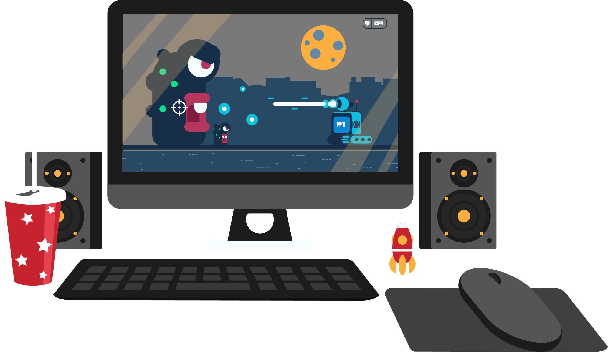

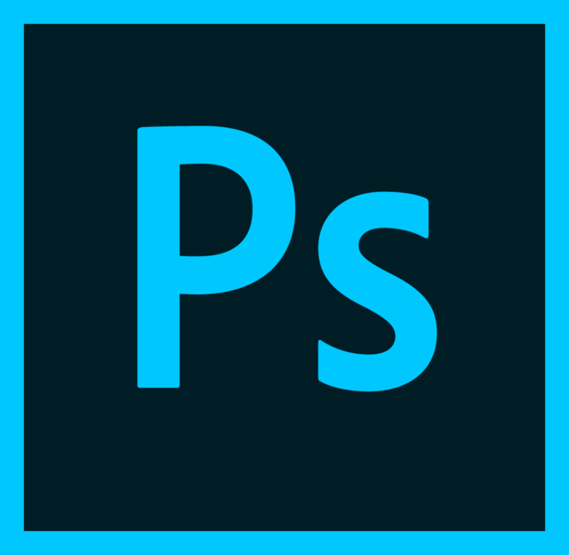

Git Bash
Bootstrap
Git Hub
CSS
Photoshop
HTML
Technologies Used
Notes:
Illustration: Freepik

Slide 7
Notes:
Illustration: Freepik

